Slide 1
CHAPTER 1 – PEOPLING OF THE WORLD
Prehistory – 2500 B.C.

Slide 2
Chapter 1 – Section 1 Human Origins in Africa
Fossil Evidence shows that the earliest humans originated in Africa.
The Search for Human Origins
Archaeologists – Find bones and artifacts that provide details of early human life such as what they look liked, what they ate, what diseases they may have had, or how long they lived.
Anthropologist – Study ancient human culture to re-create a picture of early human behavior
Paleontologist – Date bones, artifacts and fossils

Slide 3
Famous Findings
Mary Leaky 1978 – Finds footprints in Tanzania.
Australopithecines – First humanlike creature to walk upright. Humans and other created that walk upright, such as Australopithecines are called hominids.
Humans and other early creatures that walk upright, such as Australopithecines are called hominids. Hominids were able to travel more distance, spot threatening animals, and carry food and children. They had also developed opposable thumbs, which made grabbing and carrying much easier.
Donald Johanson – Finds female skeleton in Ethiopia (Lucy). She is the oldest hominid found (3.5 million years old).

Slide 4
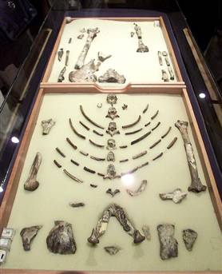
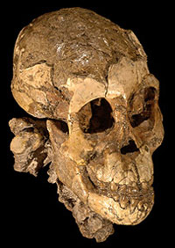

Slide 5
Progressing During Stone Age
The invention of tools, mastery of over fire, and the development of language all occurred during the Stone Age.
Paleolithic Age: 2.5 million to 8000 B.C.
Ice Age happened during the Paleolithic Age. Glaciers advanced and retreated as many as 18 times. By the last retreat the glaciers sat nearly where they are today.
Oldest stone chopping tools found in this era
Homo Habilis (Man of Skill) – First Tool Maker. Used tools to cut meat and crack open bones. Made task of living easier.
Homo Erectus (Upright Man, 1.6 million B.C.)
More intelligent and adaptable, created more tools for digging, scraping, and cutting.
Around during the same time as Homo Habilis
First to migrate and move: India, China, Southeast Asia, and Europe.
Skillful hunter, first to use fire
Developed a spoken language, helped plan hunts and created teamwork

Slide 6
Progressing During Stone Age
Neolithic Age: 8000 B.C. to 3000 B.C.
Polished stone tools, make pottery, grow crops and raise animals

Slide 7
Dawn of Modern Humans
Many scientist believe that Homo erectus developed into Homo sapiens (modern humans). Homo sapiens have much larger brains though.
Neanderthals (200,000 B.C. to 30,000 B.C.)
Originally thought to be a human ancestor but DNA test proved this wrong.
Powerfully built with heavy slanted brows, well developed muscles, and thick bones (cavemen cartoons)
Religious beliefs and rituals (including burial)
Resourceful: Built shelters to survive winter
Cro-Magnon (40,000 to 8,000 B.C.)
Early Homo Sapiens (Wise Men)
Identical to modern humans
Planned hunts: Studied animal habits and stalked prey
Advanced skill in spoken language
Migrated from North Africa to Europe and Asia.

Slide 8
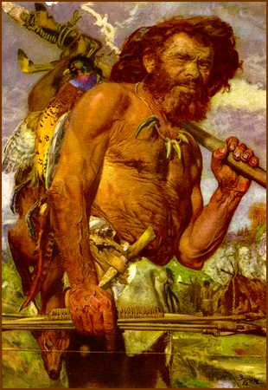
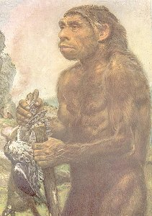

Slide 9
Reinforcement Activity
Identify – artifact, culture, hominid, Paleolithic Age, Neolithic Age, technology, Homo Sapiens
How did each of the following skills – tool making, the use of fire, and the development of language contribute to the development of hominids?

Slide 10
Chapter 1 – Section 2 Humans Try to Control Nature
Main Idea – Development of agriculture spurred an increase in population and the growth of a settled way of life.
Why it Matters? – New methods for obtaining food and the development of technology laid the foundations for modern civilizations.

Slide 11
Technology & Art
New Tool Kit
Nomads – Wander from place to place and were hunter-gatherer
They invented tools such as spears, digging sticks and knives.
Over 100 different tools were made from bone, stone and wood.
Paleolithic Art
Necklaces of seashells, lion teeth and bear claws
Sculptures of animals
Paintings – paint made from charcoal and animal blood

Slide 12
Neolithic Revolution
Known as the Agricultural Revolution
Food gathering to food producing
Causes of the Neolithic Revolution
Change in Climate – Rising temperature worldwide provided longer growing seasons and drier lands

Slide 13
Neolithic Revolution cont.
Early Farming Methods
Slash and Burn Farming – Cut trees and grass, then burn to clear land
Remaining ashes fertilized the land
Domestication of Animals – Horses, dogs, goats and pigs
Farmers and pastoral nomads participated in domesticating animals
Revolution in Jarmo (Iraq) – Development of farming communities or villages

Slide 14
Villages Grow and Prosper
Farming Develops in Many Places
Africa – The Nile River Valley – developed wheat, barley and other crops
China:
Huang He region – developed a grain called millet.
In the Chang Jiang River delta – developed wild rice
Mexico/Central America – developed corn, beans and squash
Peru – sweet and white potatoes

Slide 15
Villages Grow and Prosper cont.
Catal Huyuk – Located in South Central Turkey
Early village life (6000 people)
Large crops of wheat, barley and peas.
Raised sheep and cattle.
Development of skilled workers
Potters and weavers
Obsidian products such as mirrors, jewelry and knives
Religious relics
Big Drawbacks
Disease
Raiders

Slide 16
Chapter 1 – Section 3 Civilization
Main Idea – Prospering agricultural villages, food surpluses and new technologies led to the rise of civilization
Why It Matters? – Agriculture led to larger, more organized communities led to cities

Slide 17
Villages Grow into Cities
Invention of new tools – hoes, sickles and plow – made the task of farming easier
Farming villages grow to become cities
To cultivate more land and produce extra crops irrigation systems were developed
This resulted in food surpluses
Development of a new class of people – craftspeople
Development of Trade
The wheel and sail allowed traders to transport goods over long distances

Slide 18
Villages Grow into Cities cont.
Social Changes
Social classes with varying wealth, power and influence begin to emerge.
Organized Religion
Farmers worshipped gods that were believed to have power over rain, wind and other natural forces
Early city dwellers developed religions based on earlier religions. As populations grew, common spiritual values became lasting religious traditions

