Slide 1
Chapter 2
Physical Geography
A Living Planet

Slide 2
Terms
Weathering Atmosphere
Mechanical Weathering Lithosphere
Chemical Weathering Hydrosphere
Sediment
Erosion Divergent Boundary
Water Erosion Convergent Boundary
Glacial Erosion Transform Boundary
Wind Erosion Hydrologic Cycle
Delta Crust
Glaciations Core
Humus Tectonic Plate
Fault Earthquake
Seismograph Epicenter
Volcano Lava
All land forms on pages 34-35 Continent
Mantle Magma
Biosphere

Slide 3
Solar System
Earth is the 3rd rock from the Sun
Our Sun is the center of our Solar System, but it is just a medium sized star on the edge of the Milky Way galaxy.
Our solar system consists of 8 planets (including Earth), the Sun, and many other celestial bodies:
Comets: spheres covered with ice and dust that leave trails of vapor as they race through space
Asteroids: large chunks of rocky material. There is an asteroid belt between Jupiter and Mars.

Slide 4
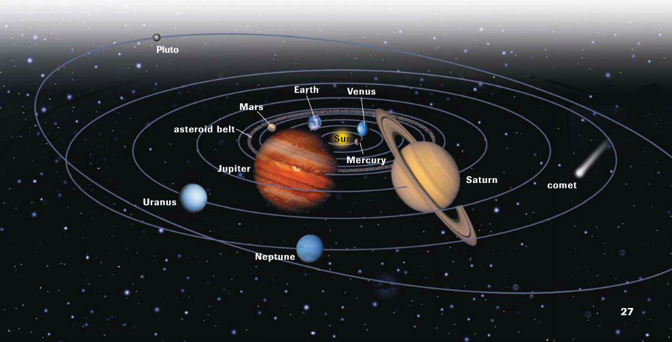

Slide 5
Structure of the Earth
Inside the Earth
Earth is about 24,900 miles in circumference and 7,900 miles in diameter.
It is not just a solid ball, but yet more of a series of shells that surround one another
The First is the Core, the core is the center of the earth and is made of iron and nickel. The outer core is liquid, but the inner core is solid (2,100 miles thick).
Surrounding the core is the mantle, which consists of several layers. The mantle contains most of the earth’s mass. Magma which is molten rock can form in the mantle and rise through the Crust (1,800 miles thick).
The Crust is the thin layer of rock at the Earth’s surface (19-37 miles thick).

Slide 6
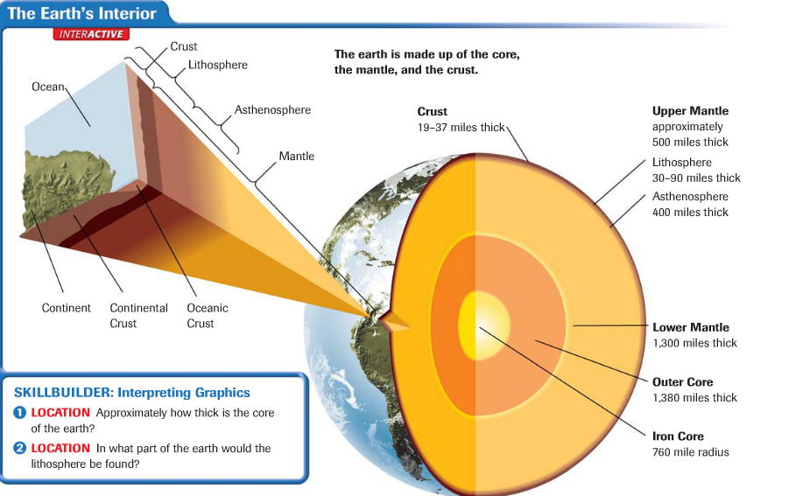

Slide 7
Structure of the Earth
Moving on from the internal structure of the Earth:
Structures On and Above the Earth
Atmosphere: layer of gasses surrounding the Earth. Contains the oxygen we breathe, protects the Earth from radiation, and keeps our weather and climate the way that it is.
Lithosphere: Solid rock portion of the earth’s surface. Includes the crust and uppermost mantle. Under the ocean the lithosphere forms the seafloor.
Hydrosphere: made up of the water elements on the Earth. Includes oceans, seas, rivers, lakes, and water in the atmosphere.
Biosphere: Formed from atmosphere, lithosphere and hydrosphere. This is the part of the earth where plants and animals live.

Slide 8
Structure of the Earth
Continental Drift
Theory presented by Alfred Wegener.
Maintains that the earth was once a supercontinent called “Pangea”, an ocean called Panthalassa surrounded it.
Pangea eventually split into many plates that drifted, crashed into each other, and split several times before they came to their current location.

Slide 9
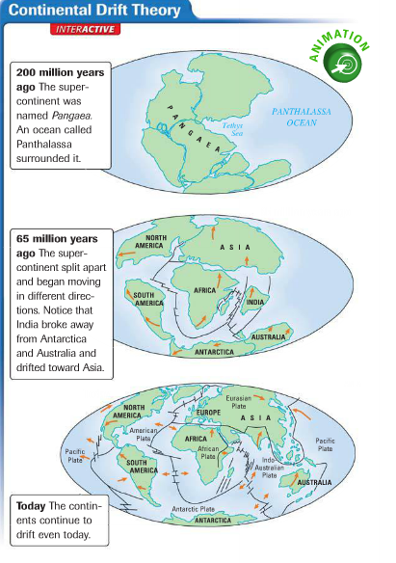

Slide 10
Review 2.1
Earth is the 3rd rock from the Sun
Earth is not just a solid ball, but yet more of a series of shells that surround one another. These shells are the core, mantle and crust.
The outer structure of the earth is composed of the Atmosphere, Lithosphere, Hydrosphere and Biosphere.
Wegener created the theory of Continental Drift, which explains the placement and shape of our continents today.

Slide 11
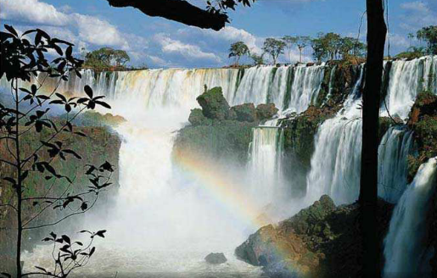
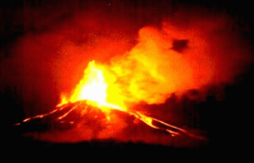
Section 2
Bodies of Water and Landforms
Earth is like any other observable planet in our solar system,
it is a living planet.

Slide 12
Bodies of Water
Without fresh water and salt water, life on our planet would be impossible. Water supports life on our planet and also is responsible for distributing heat on the earth.
Oceans and Seas
The ocean is an interconnected body of salt water that covers about 71% of our planet.
Even though it is one ocean, geographers divide it up into 4 main parts: the Atlantic Ocean, Pacific Ocean, Indian Ocean and Arctic Ocean.
The largest of these oceans is the Pacific.
Sometimes the waters near Antarctica are called the South Ocean.

Slide 13
Bodies of Water
Ocean Motion
Salt water of the ocean circulates through three basic motions: currents, waves, and tides.
Currents act like rivers flowing through the ocean.
Waves are swells or ridges produced by winds.
Tides are the regular rises and falls of the ocean created by the gravitational pull of the Sun or Moon.
The motion of the ocean helps distribute heat on the planet. Winds blow over the ocean and are either heated or cooled by the water. When the winds eventually blow over the land, they moderate the temperature over the land.

Slide 14
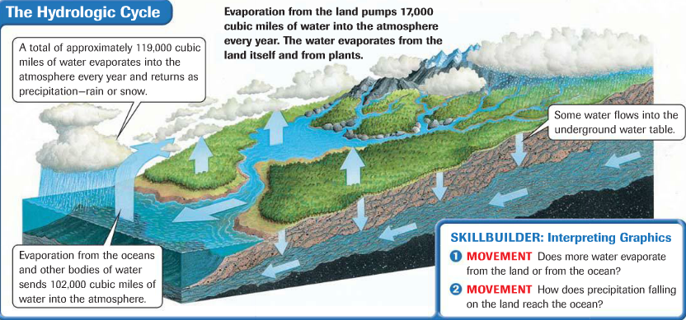
Bodies of Water
Hydrologic Cycle
Is the continuous circulation of water between the atmosphere, oceans, and earth.
Water evaporates into the atmosphere from the surface of the oceans, other bodies of water, and plants. The water exists in the atmosphere as vapor, eventually the vapor cools condenses and falls and precipitation. The water soaks into the ground, evaporates to the atmosphere, or flows into rivers to be recycled.

Slide 15
Bodies of Water
Lakes, Rivers, and Streams
Lakes hold more than 95% of all the earth’s fresh water supply.
Lakes like the Great Lakes in North America are a result of glacial action thousands of years ago.
Saltwater lakes result from changes in the earth’s surface that cut off outlets to the sea. Saltwater lakes are created when creeks and rivers carry salts into a lake and there is no outlet to carry the salt away.
Rivers and streams flow through channels and move water to or from larger bodies of water. Rivers and steams connect into drainage systems that work like the branches of a tree with smaller branches called tributaries, feeding into larger and larger ones.
Geographers call an area drained by a major river and its tributaries a drainage basin.

Slide 16
Bodies of Water
Ground Water
Some water on the surface of the earth is held by the soil, and some flows into the pores of rock below the soil.
The water held in the pores of rock is called “Ground Water”
The level at which the rock is saturated marks the rim of the water table.
The water table can rise or fall depending on the amount of precipitation in the region and on the amount of water pumped out of the ground.

Slide 17
Landforms
Landforms are naturally formed features on the surfaces of the earth.
Become familiar with all of the following landforms:
Volcano, Strait, Island, Swamp, Flood Plain, Delta, Marsh, Mouth (river), Harbor, Bay/Gulf, Sea Level, Cape/Peninsula, Prairie, Steppe, Mountain, Valley, Glacier, Mesa, Plateau, Cataract, Canyon, Plateau, Cliff

Slide 18
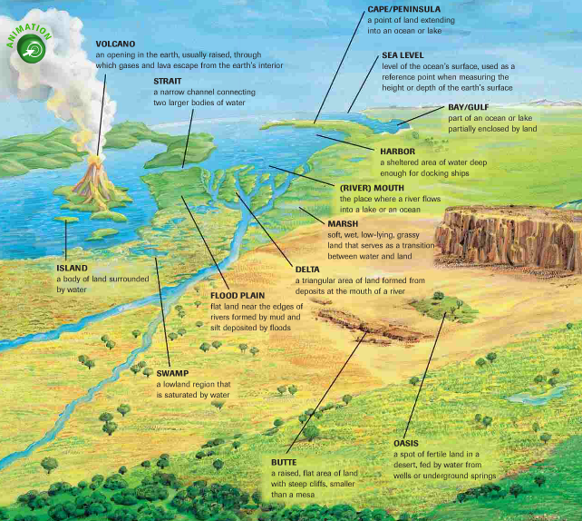
Landforms

Slide 19
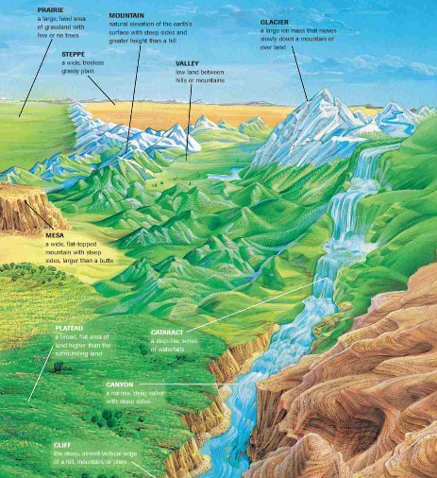
Landforms

Slide 20
Landforms
Oceanic Landforms
The earth’s surface from the edge of a continent to the deep part of the ocean is called the Continental Shelf.
Mountain chains similar to those on the continents themselves cover parts of the ocean floor.
Islands do the ocean surface. Islands can be formed by volcanic action, deposits of sand and deposits of coral skeletons.
Continental Landforms
Relief is the difference in elevation of a landform from its lowest point to its highest point.
There are four categories of relief: mountains, hills, plains, and plateaus.
Topography is the combination of the surface shape and composition of the landforms and their distribution in a region.

Slide 21
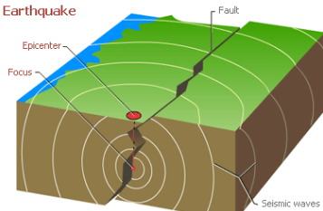
Section 3
Internal Forces Shaping the Earth

Slide 22
Plate Tectonics
Plate Movement
The internal forces that shape the earth’s surface begin beneath the lithosphere.
Rock in the asthenosphere is hot enough to flow slowly, heated rock rises, moves up toward the lithosphere , cools, and circulates downward.
Riding above this circulation sys are the tectonic plates, enormous moving pieces of the earth’s lithosphere.
Geographers study the movement of the plates and the changes they cause in order to understand how the earth is continually being shaped and how earthquakes and volcanoes occur.

Slide 23
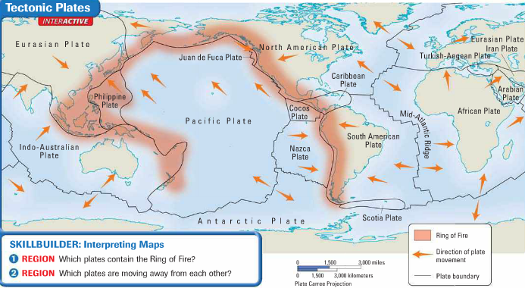
Plate Tectonics
Here are the positions of the tectonic plates in the map below.

Slide 24
Plate Tectonics
Plate Movement
Tectonic plates move in one of four ways; 1. Spreading or moving apart, 2. subduction or diving under another plate, 3. collision or crashing into one another, or 4. sliding past each other.
When tectonic plates come into contact, changes on the earth’s surface occur. Three types of boundaries mark plate movement.
Divergent Boundary: plates move apart, spreading horizontally.
Convergent Boundary: plates collide, causing one plate to dive under the other or the edges of both plates to crumble.
Transform Boundary: plates slide past one another.

Slide 25
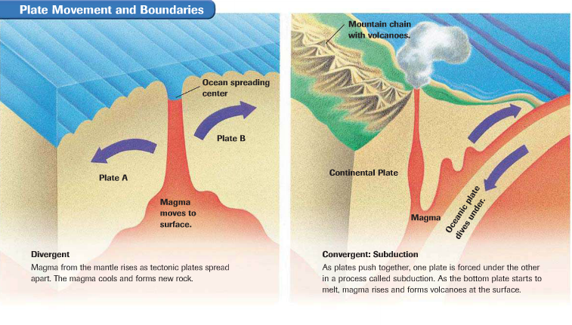
Plate Movement and Boundaries

Slide 26
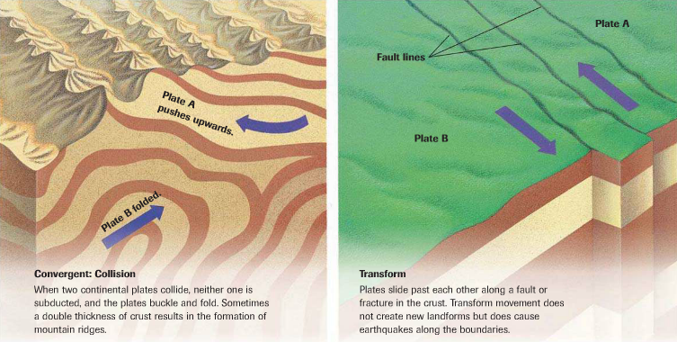
Plate Movement and Boundaries

Slide 27
Plate Tectonics
Folds and Faults
When two plates meet each other, they can cause folding and cracking of the rock.
The rocks which are under great pressure, become more flexible and bend or fold, creating changes in the crust.
However sometimes the rock is not flexible and will crack under the pressures exerted by the plate movement.
The fracture in the earth’s crust is called a fault. It is at the fault line that the plates move past each other.

Slide 28
Earthquakes
As the plates grind or slip past each other at a fault, the earth shakes or trembles. This sometimes violent movement is an Earthquake.
Thousands of earthquakes occur every year, but most are so slight that you cannot feel them. Only a seismograph, a machine that measures the size of the waves created by the earthquake, can detect them.
Earthquake Locations
The location in the earth where an earthquake begins is called the focus. The point directly above the focus on the earth’s surface is the epicenter.

Slide 29
Earthquakes
Earthquake Damage
Earthquakes result in squeezing, stretching, and shearing motions of the earth’s crust that damage land and structures.
Changes are most noticeable where people live. Landslides, displacement of land, fires, and collapsed buildings are some of the outcomes from earthquakes.
Aftershocks: smaller earthquakes, may occur for days after the initial earthquake.
The Richter Scale measure the information collected by seismographs to determine the strength of the earthquake.
A 4.5 earthquake would be newsworthy, while a major earthquake would be 7.
Tsunami
Earthquakes sometimes cause Tsunamis, which are giant waves. They can travel across wide stretches of the ocean and do damage on distant shores.

Slide 30
Volcanoes
Magma, gases, and water from the lower part of the crust or the mantle collect in underground chambers. Eventually the materials pour our of a crack in the earth’s surface. This is called a volcano.
Most volcanoes are found along tectonic plate boundaries.
Volcanic Action
Magma that has reached the earth’s surface is called lava. The most dramatic volcanic action is the eruption.
Volcanoes do not erupt on a predictable schedule. They may be active for many years and then just suddenly stop.

Slide 31
Volcanoes
Ring of Fire
A zone around the rim of the Pacific Ocean, is the location of the vast majority of active volcanoes.
Eight major tectonic plates meet in this zone.
Volcanic action and earthquakes occur here regularly.
Other volcanoes are located far from the margins of tectonic plates.
They appear over “hot spots” where magma from deep in the mantle rises and melts through the lithosphere, as in volcanoes in the Hawaiian Islands.

Slide 32
Section 4
External Forces Shaping the Earth
External forces, such as weathering and erosion, also alter landscapes.
Weathering refers to the physical and chemical processes that change the characteristics of rock on or near the earth’s surface.
Weathering occurs over many years.
Weathering processes create smaller and smaller pieces of rock called sediment.
Sediment is mostly identifiable as either mud, sand, or silt, which is very fine particles of rock.

Slide 33
Weathering
Mechanical Weathering
Process that break rock into smaller pieces are referred to as mechanical weathering. Mechanical weathering does not change the composition of the rock, only its size.
Ice crystals could build up in a crack of the rock, this could build up enough pressure to fracture it.
Plant roots may break up the rocks
Human activities like road construction or blasting and drilling in mining could lead to the weathering as well.

Slide 34
Weathering
Chemical Weathering
Occurs when rock is changed into a new substance as a result of interaction between elements in the air or water and the minerals in the rock.
Decomposition can happen in several ways. Some minerals react to oxygen in the air and begin to crumble. Like when iron rusts.
Other minerals break down when combined with water or carbon dioxide, which form weak acids within the rock. When sulfur and nitrogen oxides mix with water, acid rain is formed.
Climates that are warm and moist will produce more chemical weathering than do cool dry areas. Rocks in cold dry and hot areas generally experience more mechanical weathering than chemical weathering.

Slide 35
Erosion
Occurs when weathered material is moved by the action of wind, water, ice or gravity.
For erosion to occur, a transporting agent, such as water, must be present. Glaciers, waves, and stream flow, or blowing winds cause erosion by grinding rock into smaller pieces.
Erosion in its many forms reshapes landforms and coastal regions, as well as riverbeds and riverbanks

Slide 36
Erosion
Water Erosion
One form of water erosion occurs as water flows in a stream or river. The motion picks up loose materials and moves it downstream.
Another form is abrasion, the grinding away of rock by transported particles. The heavier the load of sediment, the greater the abrasion on the banks and riverbeds.
The third occurs when water dissolves chemical elements in the rock. The composition of the rock is then changed.
Most streams erode both vertically and horizontally, the valley cut by a stream gets deeper and wider, forming a v-shaped valley.
When a river enters the ocean, the sediment is deposited in a fan like landform called a delta.
Wave action along the coastline changes the land. Waves can reduce or increase beaches.

Slide 37
Erosion
Wind Erosion
Is similar to water erosion because the wind transports and deposits sediment in other locations.
Wind speeds must reach 11 miles per hour before the sediment can be moved. The greater the speed the bigger the particles are that are moved.
Deposits of loess, blown silt, and clay sediment that produce fertile soil are blown across the world.
This is how sand dunes, miles away from seashores, can be formed.

Slide 38
Erosion
Glacial Erosion
A glacier is a large, long-lasting mass of ice that moves because of gravity. Glaciers form in mountainous areas and in regions that are routinely covered with heavy snowfall and ice. In mountain regions, glaciers move downslope because of gravity.
Glaciation is the changing of landforms by slowly moving glaciers. As a glacier moves, several types of erosion occur. Rocks caught underneath the glacier are ground into finer and finer parcticles.
Rocks left behind a glacier may form a ridge or hill called a moraine. Moraines can be found on the sides, down the center, or at the leading edge of a glacier.

Slide 39
Building Soil
Weathering and erosion are part of the process of forming soil. Soil is the loose mixture of weathered rock, organic matter, air and water that supports plant growth.
Soil Factors
When geographers study soil, they look at five factors.
Parent Material: the chemical composition of the original rock, or parent rock, before it decomposes affects its fertility.
Relief: steeper slopes are eroded easily and do not produce soil quickly.
Organisms: include plants, small animals like worms, ants, and bacteria that decompose material. They help loosen soil and supply nutrients for plants.
Climate: hot climates produce a soil different from that produced by cold climates. Wet climates and dry climates produce soils that are different from each other as well.
Time: the amount of time to produce soil varies, but a very rough average is about 2.5 cubic centimeters per century.
The variety of soils and the climates in which they are found determine the types of vegetation that can grow in a location.

