Slide 1
Chapter 12 Physical Geography of Europe: The Peninsula of Peninsulas
Because of its unique geography and weather patterns, Europe’s landscapes, waterways, and climates vary greatly.

Slide 2
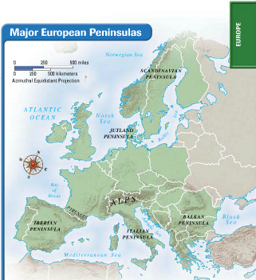
Section 1: Landforms and Resources
Section 2: Climate and Vegetation
Section 3: Human-Environment Interaction

Slide 3
Section 1: Landforms and Resources
• Europe is composed of many peninsulas and islands.
• Europe’s landforms also include large plains and mountain ranges.

Slide 4
Section 1: Landforms and Resources
Peninsulas and Islands
Always Near the Water
• Europe is a large peninsula of Asia
- also has its own smaller peninsulas: a “peninsula of peninsulas”
- most places are within 100 miles of the ocean or a sea

Slide 5
Continued Peninsulas and Islands
Northern Peninsulas
• The Scandinavian Peninsula includes Norway and Sweden
- bounded by Norwegian, North, and Baltic Seas
• Ice Age glaciers remove topsoil; leave thin, rocky soil
• Glaciers create fjords in Norway
- steep U-shaped valleys connected to sea, filled with seawater
- provide harbors for fishing boats
• Jutland Peninsula forms large part of Denmark, small part of Germany
- gentle, rolling hills and swampy low areas

Slide 6
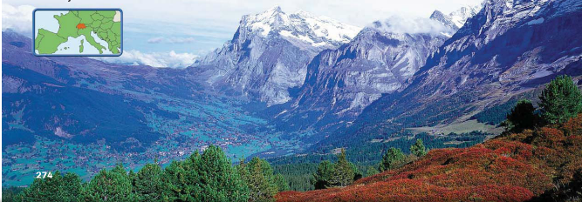
Mountains and Uplands
Mountain Chains
• The Alps is Europe’s most famous mountain chain
- crosses France, Italy, Germany, Switzerland, Austria, Balkans
- cuts Italy off from rest of Europe
• Pyrenees block movement from France to Spain and Portugal
• Apennine Mountains divide Italian Peninsula between east, west
• Balkan Mountains block off peninsula, separate ethnic groups

Slide 7
Continued Mountains and Uplands
Uplands
• Uplands—hills or low mountains; may have mesas, high plateaus
- some are eroded remains of mountain ranges
• Uplands include Scandinavian Kjolen Mountains, Scottish Highlands
- also Brittany in France and the Meseta plateau in Spain
• Some uplands border mountainous areas
- Central Uplands of Germany at base of Alps
- Massif Central uplands in France

Slide 8
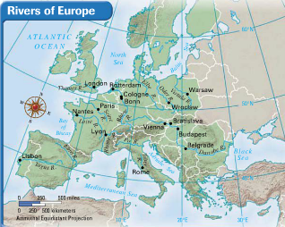
Rivers: Europe’s Links
Moving People, Goods, Ideas
• Network of rivers bring people, goods together
- allows goods inland from coastal harbors, aids economic growth
• Two major, castle-lined rivers have historically acted as highways
- Rhine flows north 820 miles from interior to North Sea
- Danube flows east 1,771 miles, through 9 countries, to Black Sea
• These and many other rivers connect Europeans
- encourage trade and travel

Slide 9
Fertile Plains: Europe’s Bounty
The Northern European Plain
• One of the most fertile agricultural regions in world
• Curves across France, Belgium, Netherlands, Denmark, Germany, Poland
- flat agricultural land produces vast quantities of food
• Flatness also has given invaders an open route into Europe
• Other, smaller, fertile farming plains:
- Sweden, Hungary, northern Italy’s Lombardy

Slide 10
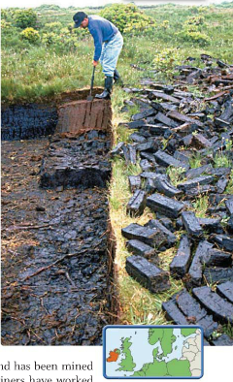
Resources Shape Europe’s Economy
Fueling Industrialization
• Coal and iron ore are needed to create steel for industrialization
- found in Belgium, Netherlands, France, Germany, Poland
• Major industrialized regions:
- Ruhr Valley, Germany; parts of United Kingdom

Slide 11
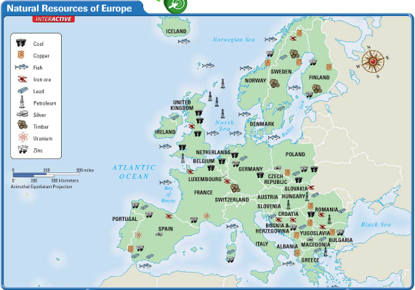
Continued Resources Shape Europe’s Economy
Energy
• Oil, natural gas found in North Sea in 1959; offshore rigs in 1970s
- petroleum supplied by Norway, Netherlands, Britain
Agricultural Land
• 33% of Europe is suitable for agriculture; world average only 11%

Slide 12
Resources Shape Life
Affecting All Parts of Life
• Resources affect food, jobs, houses, even culture
- for example, folk tales set in deep, dark forests of Old Europe
• Distribution of resources creates regional differences
- for fuel, Irish burn peat—partially decayed plant matter from bogs
- Polish miners have worked coal mines for generations

Slide 13
Section 2: Climate and Vegetation
• Much of Europe has a relatively mild climate because of ocean currents and warm winds.
• Eastern Europe has a harsher climate because it is farther from the Atlantic Ocean.

Slide 14
Section 2: Climate and Vegetation
Westerly Winds Warm Europe
A Mild Climate for a Northern Latitude
• Marine west coast climate: warm summers, cool winters
- Spain, France, Poland, British Isles, coastal Scandinavia
• North Atlantic Drift—warm-water tropical current flows by west coast
- prevailing westerlies carry current’s warmth, moisture inland
• Alps’ high elevation creates colder climate, deep winter snows

Slide 15
Continued Westerly Winds Warm Europe
Forests to Farms
• Original mixed forests cleared for farming
- grow grains, sugar beets, livestock feed, potatoes

Slide 16
Harsher Conditions Inland
Not Reached by Westerly Winds
• Humid continental climate: cold, snowy winters; warm or hot summers
- Sweden, Finland, Romania; eastern Poland, Slovakia, Hungary
• Adequate rainfall for agriculture
• Heavy deforestation; surviving trees are mostly coniferous
• Broad, fertile plains were once covered with grasses
- today, wheat, rye, barley, potatoes, sugar beets grow

Slide 17
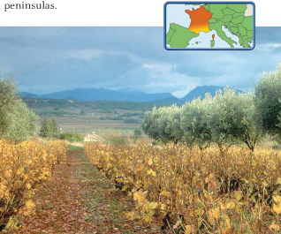
The Sunny Mediterranean
An Appealingly Mild Climate
• Mediterranean climate: hot, dry summers; mild, wet winters
- Italy, Greece and southern Spain, France
- mountain block cold north winds
Special Winds
• Mediterranean coast of France is not protected by mountains
- mistral—a cold, dry winter wind from north
• Sirocco—hot North African wind carries sea moisture or desert dust

Slide 18
Continued The Sunny Mediterranean
The Climate Attracts Tourists
• Vegetation is evergreen shrubs, short trees
- major crops: citrus fruits, olives, grapes
• Sunny beaches attract tourists

Slide 19
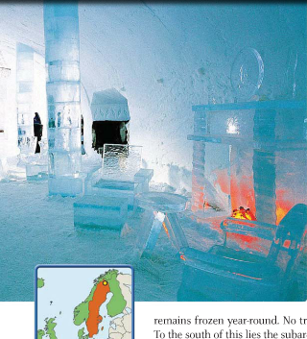
Land of the Midnight Sun
Cold, Dark Winters
• Tundra climate in far northern Scandinavia, along Arctic Circle
- permafrost with no trees, only mosses, lichens
• South of tundra is subarctic climate: cool with cold, harsh winters
- little growth except stunted trees
• Region’s sunlight varies sharply: long winter nights, summer days
- area north of Arctic Circle the Land of the Midnight Sun
- some winter days have no sun, some summer days have no night

Slide 20
Section 3: Human-Environment Interaction
• The Dutch and the Venetians altered lands to fit their needs by constructing
polders and canals.
• Uncontrolled logging and acid rain destroy forests.

Slide 21
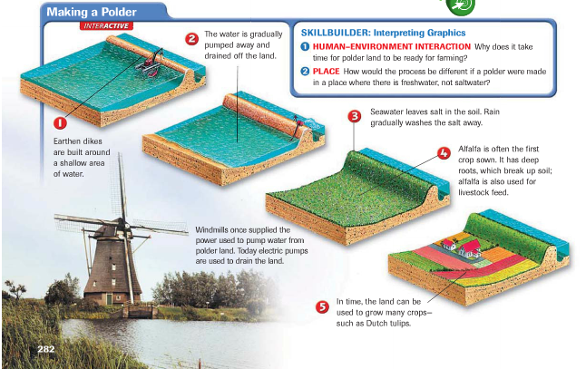
Section 3: Human-Environment Interaction
Polders: Land from the Sea
Creating Holland
• “God created the world, but the Dutch created Holland”
- to hold growing population, the Dutch reclaimed land from the sea
- 40% of the Netherlands was once under water
- dikes—earthen banks that hold back the sea
- a polder—land reclaimed by diking and draining

Slide 22
Continued Polders: Land from the Sea
Seaworks
• Seaworks—structures like dikes that control sea’s destructive force
- terpen—high earthen platforms that provide safe ground during floods
• In 1400s windmills were used to power pumps that drained land
- today the pumps are powered by electricity

Slide 23
Continued Polders: Land from the Sea
Transforming the Sea
• Zuider Zee—arm of North sea the Dutch turned into a fresh-water lake
• Built dikes across entrance in early 1900s
- saltwater eventually replaced by fresh water
• Project added hundreds of square miles of land to the Netherlands
- lake is now called Ijsselmeer

Slide 24
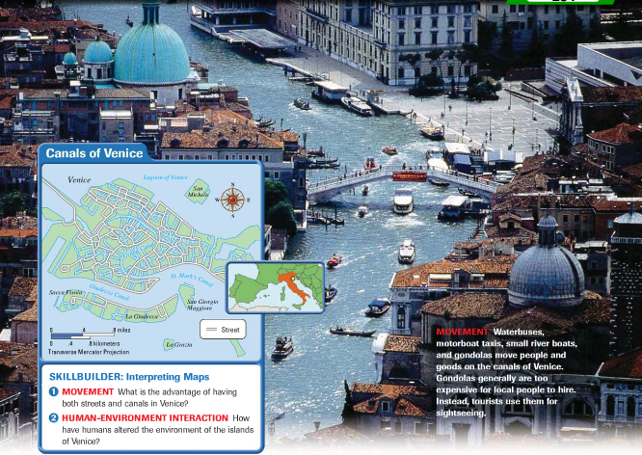
Waterways for Commerce: Venice’s Canals
An Island City Grows
• City of Venice is made up of 120 islands
- two of the largest are San Marco and Rialto
• People, goods are moved by boat over 150 canals
• City forms when people escaping invaders settled on lagoon islands
- location at north end of Adriatic makes it a good trading port

Slide 25
Continued Waterways for Commerce: Venice’s Canals
Building on the Islands
• Builders sunk wooden pilings into swampy land to support buildings
- oak forests in northern Italy and Slovenia were leveled for pilings
- weight of buildings is compressing ground, so Venice is slowly sinking
• Rising sea levels and removal of groundwater also cause sinking

Slide 26
Continued Waterways for Commerce: Venice’s Canals
Problems Today
• Severe water pollution
- industrial waste, sewage, saltwater eat away foundations
- erosion lets saltwater in, creates floods such as in 1966
• Agricultural runoff promotes “killer algae” growth
- algae grow rapidly, die, decay; this uses up oxygen, so fish die
- dead fish attract insects and create stench in warm weather

Slide 27
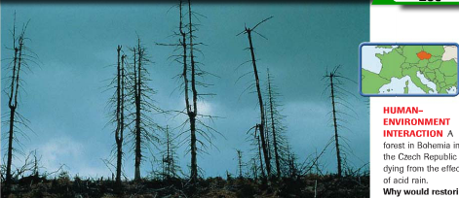
A Centuries-Old Problem: Deforestation
The Demand for Wood
• Huge areas of Europe fall prey to deforestation
• Wood used for fuel, building material for ships, houses
- industry needed wood charcoal for blast furnaces
- eventually coal replaces wood, but damage to forests is done

Slide 28
Continued A Centuries-Old Problem: Deforestation
Acid Rain Strips Forests
• In 1960s Germans notice Black Forest trees are discolored, dying
- cause is acid rain
• Factories produce sulfur dioxide, nitrogen oxide emissions
- combine with water vapor, create acid rain or snow
- winds carry emissions to other areas, affecting one-fourth of forests
• Scandinavia suffers heavily due to prevailing winds

