Slide 1
Chapter 32 World War II, 1939–1945
The Allies defeat the Axis powers, the Jewish people suffer through the
Holocaust, and Europe and Japan are devastated by World War II.

Slide 2
Section 1: Hitler’s Lightning War
Section 2: Japan’s Pacific Campaign
Section 3: The Holocaust
Section 4: The Allied Victory
Section 5: Europe and Japan in Ruins

Slide 3
Section 1: Hitler’s Lightning War
Using the sudden, mass attack called the blitzkrieg, Germany overruns much of Europe and North Africa.

Slide 4
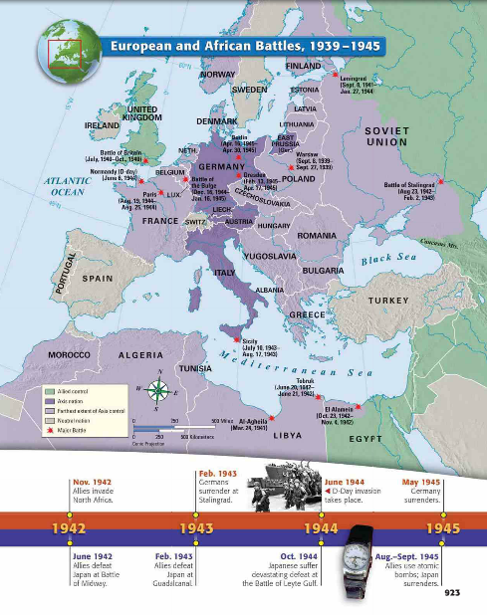

Slide 5
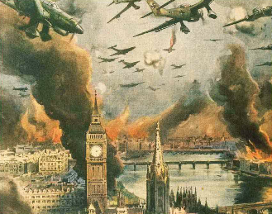
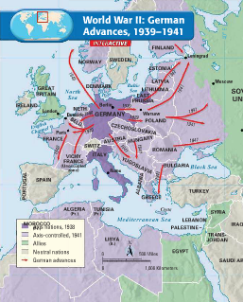
Section 1: Hitler’s Lightning War
Germany Sparks a New War in Europe
Secret Agreement
• Nonaggression pact—Germans, Soviets agree not to fight each other
• Agreement includes secret deal to split Poland
Germany’s Lightning Attack
• September 1, 1939—Hitler launches invasion of Poland
• Britain, France declare war on Germany but Poland falls quickly
• Blitzkrieg—lightning war—Germany’s new military strategy
• Planes, tanks, infantry used to surprise enemy and quickly conquer

Slide 6
Germany’s Lighting Attack
The Soviets Make Their Move
• Soviets capture Lithuania, Latvia, Poland, resistance met in Finland
• Finland surrenders in March 1940
The Phony War
• French, British mobilize along French border, wait for German attack
• Many months of no action—the “phony war”
• In April 1940 Hitler attacks and quickly captures Denmark, Norway

Slide 7
The Fall of France
Further Gains
• May 1940—Germany conquers Netherlands, Belgium, Luxembourg
• Soon after, German army reaches French coast
Rescue at Dunkirk
• German forces trap British, French on coast at Dunkirk
• British Navy, civilians take ships across Channel to rescue soldiers
France Falls
• June 1940—France surrenders to Germany
• Charles de Gaulle, French general, organizes opposition to Germany

Slide 8
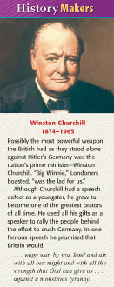
The Battle of Britain
Threat to Britain
• Winston Churchill—Becomes British prime minister, vows no surrender
• Germany plans invasion of Britain; begins with air attacks in 1940
• British use air force, radar, code-breaking to resist Germany
• Battle of Britain—Air war over Britain that lasted until May 1941
• Stunned by British resistance, Hitler calls off attacks

Slide 9
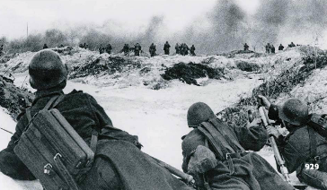
The Mediterranean and the Eastern Front
Axis Forces Attack North Africa
• Mussolini, Italy at first neutral
• Mussolini declares war on France, Britain after German victory
• September 1940—Mussolini attacks British in North Africa
Britain Strikes Back
• December 1940—British attack and drive Italians back
• Erwin Rommel, German general, battles British in North Africa
• In 1942, Rommel first retreats then succeeds against British

Slide 10
Continued The Mediterranean and the Eastern Front
The War in the Balkans
• Hitler plans to invade Soviet Union; moves to take Balkan countries
• Hitler invades Yugoslavia, Greece in April 1941; both fall quickly
Hitler Invades the Soviet Union
• Germany invades an unprepared Soviet Union in June 1941
• Soviet troops burn land as they retreat; Germans move into Russia
• Germans stopped at Leningrad, forced to undertake long siege
• Germans almost capture Moscow, but forced to pull back

Slide 11
The United States Aids Its Allies
American Policy
• Most Americans want to avoid war
• Roosevelt fears that if allies fall, U.S. would have to fight
• He hopes to strengthen allies so they can resist Germany
• Lend-Lease Act—U.S. loans weapons to countries fighting Germany
• Roosevelt and Churchill meet, issue statement of principles
• Atlantic Charter—supports free trade, right to form own government

Slide 12
Section 2: Japan’s Pacific Campaign
Japan attacks Pearl Harbor in Hawaii and brings the United States into World War II.

Slide 13
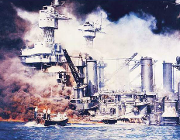
Section 2: Japan’s Pacific Campaign
Surprise Attack on Pearl Harbor
Japan and the U.S.
• Japan develops plan for attacks on European colonies, U.S. bases
• In 1941 Roosevelt cuts off oil shipments to Japan
- Admiral Isoroku Yamamato plans attack on U.S. fleet in Hawaii
Day of Infamy
• Japan attacks Pearl Harbor—U.S. naval base in Hawaii—on Dec. 7, 1941
• U.S. declares war on Japan
• Japan also attacks Hong Kong, Thailand, and other islands

Slide 14
Japanese Victories
Gains in Many Places
• Japanese attack Philippine Islands defended by U.S., Filipino troops
• Philippine islands fall to Japanese in 1942
• Japan captures British holdings, including Hong Kong, Singapore
• Also conquers Dutch East Indies, rich in minerals
• Capture of Burma threatens India, Britain’s main possession in Asia
• Japanese forces treat conquered peoples, prisoners of war brutally

Slide 15
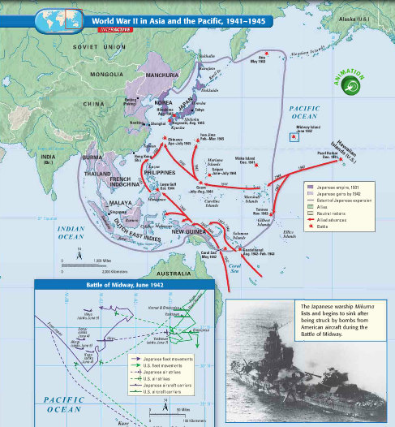

Slide 16
The Allies Strike Back
Stunning Raid
• U.S. bombers attack Tokyo, other Japanese cities in April 1942
• Raid does little damage, but shows that Japan is vulnerable
The Allies Turn the Tide
• Battle of the Coral Sea—Americans stop Japanese advance, May 1942
• New kind of naval warfare—ships launch planes to fight each other
The Battle of Midway
• Japanese send powerful fleet to capture Midway Island
• Battle of Midway—U.S. destroys Japan’s naval fleet, Japan retreats

Slide 17
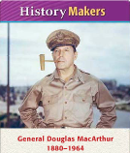
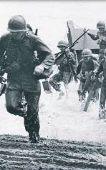
An Allied Offensive
MacArthur’s Plan
• Douglas MacArthur—American army commander in Pacific
• Plans to “island-hop” past strongholds, attack weaker Japanese bases
• Battle of Guadalcanal—hellish battle that ends in Allied victory

Slide 18
Section 3: The Holocaust
During the Holocaust, Hitler’s Nazis kill 6 million Jews and 5 million other “non-Arayans.”

Slide 19
Section 3: The Holocaust
The Holocaust Begins
Racist Beliefs
• Hitler and Nazis say Aryans—Germanic peoples—are “master race”
• They launch the Holocaust—systematic murder of Jews and others
Anti-Semitism
• Nazis tap into long-held feeling of many Europeans against Jews
• 1935 Nuremberg Laws take away rights of German Jews
“Night of Broken Glass”
• Kristallnacht—“night of broken glass,” November 9, 1938
• Jewish homes, businesses, synagogues attacked; 100 Jews killed

Slide 20
Continued The Holocaust Begins
A Flood of Refugees
• Fearing more violence, many German Jews flee to other countries
• Hitler favors emigration but other countries limit Jewish refugees
Isolating the Jews
• Hitler has all Jews moved to designated cities
• They are forced to live in ghettos—separate Jewish areas
• Hitler hopes that Jews in ghettos will die of disease, starvation
• Despite bad conditions, Jews survive in these areas

Slide 21
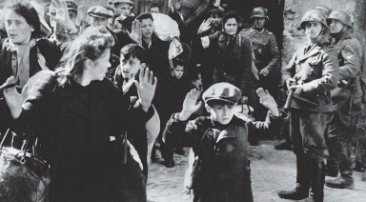
Hitler Seeks New Answer
• “Final Solution”—Hitler’s final plan for treatment of Jews
• Chooses genocide—systematic killing of an entire people
The Killings Begin
• Nazis in Eastern Europe, Soviet Union create killing squads
• They shoot men, women, children in mass executions
• Other Jews sent to concentration camps or slave labor prisons

Slide 22
Continued The “Final Solution”
The Final Stage
• By 1942, Nazis building huge, efficient extermination camps
• Camps separate strong from weak people
• Weak (mostly women, children, elderly, sick) killed immediately
The Survivors
• Nazis kill about six million European Jews during the war
• Fewer than four million survive

Slide 23
Section 4: The Allied Victory
Led by the United States, Great Britain, and the Soviet Union, the Allies score key victories and win the war.

Slide 24
Section 4: The Allied Victory
The Tide Turns on Two Fronts
The North African Campaign
• Rommel takes Tobruk, June 1942; pushes toward Egypt
• British General Montgomery attacks at El Alamein, forces Rommel back
• American forces land in Morocco, November 1942
• General Dwight D. Eisenhower—American commander in Morocco
• In May 1943, Rommel’s forces defeated by Allies

Slide 25
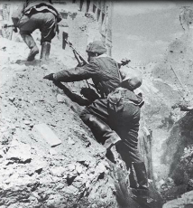
Continued The Tide Turns on Two Fronts
The Battle for Stalingrad
• German army moves to capture Soviet oil fields
• Battle of Stalingrad—Soviets, Germans battle for control of city
• German troops capture city, then surrender after long battle
The Invasion of Italy
• U.S., British forces land on, capture Sicily, in 1943
• Mussolini loses power but Germans keep control of northern Italy
• Allies invade Italy, but Germans keep fighting there until war ends

Slide 26
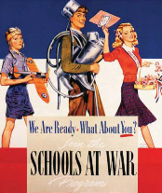
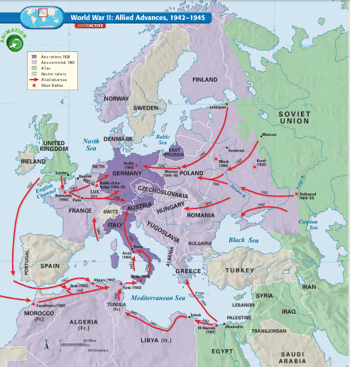
The Allied Home Fronts
Mobilizing for War
• Fighting the war requires complete use of all national resources
• 17 to 18 million U.S. workers—many of them women—make weapons
• People at home face shortages of consumer goods
• Propaganda aims to inspire civilians to aid war effort
War Limits Civil Rights
• Japanese Americans face prejudice, fear
• Army puts Japanese Americans in interment camps in 1942

Slide 27
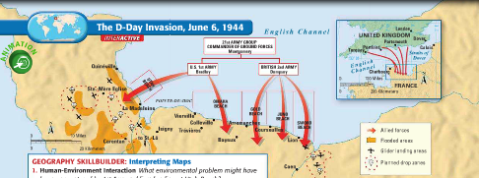
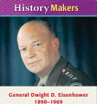
Victory in Europe
The D-Day Invasion
• Allies plan invasion of France; use deception to confuse Germans
• D-Day—June 6, 1944; day of “Operation Overlord” invasion of France
• Allied forces capture Normandy beaches; liberate Paris by September
The Battle of the Bulge
• U.S., British forces advance on Germany from west, Soviets from east
• Battle of the Bulge—German counterattack in December 1944
• Germans gain early success but forced to retreat

Slide 28
Continued Victory in Europe
Germany’s Unconditional Surrender
• By 1945, Allied armies approach Germany from two sides
• Soviets surround Berlin in April 1945
• Hitler commits suicide
• On May 9, 1945, Germany officially surrenders, marking V-E Day
• President Roosevelt dies in April; Harry Truman becomes president

Slide 29
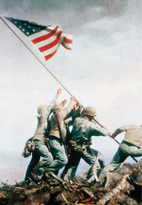
Victory in the Pacific
The Japanese in Retreat
• Allies move to retake the Philippines in late 1944
• Battle of Leyte Gulf leaves Japanese navy badly damaged
• Kamikazes—Japanese pilots who fly suicide missions
• In March 1945, American forces capture Iwo Jima
• U.S. takes Okinawa in June 1945; Japan suffers huge casualties

Slide 30
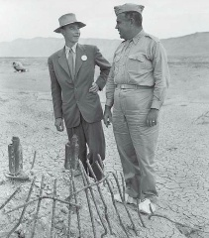
Continued Victory in the Pacific
The Japanese Surrender
• Advisors warn Truman that invasion of Japan will cost many lives
• He has alternative; powerful new weapon called atomic bomb
• Manhattan Project—secret program to develop the bomb
• Atomic bomb dropped on Hiroshima, August 6, 1945; about 75,000 die
• Nagasaki bombed on August 9; 70,000 die immediately
• Japanese surrender on September 2, 1945

Slide 31
Section 5: Europe and Japan in Ruins
World War II cost millions of human lives and billions of dollars in damages. It leaves Europe and Japan in ruins.

Slide 32
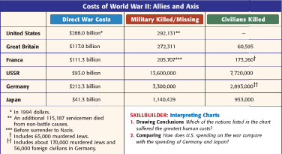
Section 5: Europe and Japan in Ruins
Devastation in Europe
A Harvest of Destruction
• Many cities across Europe badly damaged by war
• Many people displaced by war and peace agreements
Misery Continues After the War
• Lack of food, destruction of roads, factories lead to hardship
• Many people suffer from hunger, disease after war

Slide 33
Postwar Governments and Politics
Need for New Leaders
• Many conquered countries went back to old governments
• New leaders needed in Germany, Italy, and France
• Communist parties make gains in Italy, France by promising change
• Communist interest fades as economies recover
The Nuremberg Trials
• Nuremberg Trials—trials of 22 Nazi leaders for war crimes
• Some Nazi leaders are executed for their actions

Slide 34
Postwar Japan
Serious Damage
• In war, Japan loses two million people; severe damage to many cities
Occupied Japan
• MacArthur takes charge of U.S. occupation of Japan
• Starts process of demilitarization—disbanding Japan’s armed forces
• Also launches democratization—creating democracy in Japan
• Japanese people adopt new constitution in 1947
• MacArthur puts economic reforms in place

Slide 35
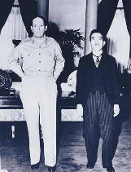
Occupation Brings Deep Changes
Changing Japanese Society
• Emperor kept on, but he loses power and becomes figurehead
• Japanese people elect two-house legislature
• Bill of rights guarantees freedoms; women also have right to vote
• Constitution says Japan cannot attack another country
• In 1951, peace treaty with Japan signed; U.S. occupation ends
• U.S. and Japan become allies

Slide 38
